Slide 1


CZI-1: Universal Biomedical Sentence Embeddings
Surya Teja Devarakonda, Rohan Gangaraju, Ao Liu, Kushagra Pundeer
PhD Mentor: Tu Vu
Industrial Mentor: Ivana Williams

Slide 2


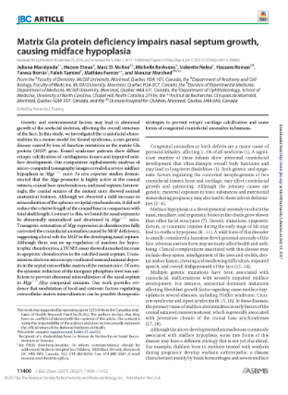

Demand for Biomedical NLP
~ 1 MILLION PAPERS PER YEAR
Notes:
Motivation
New tools to enable R&D and handle Enormity of Research papers
Helping researchers

Slide 3
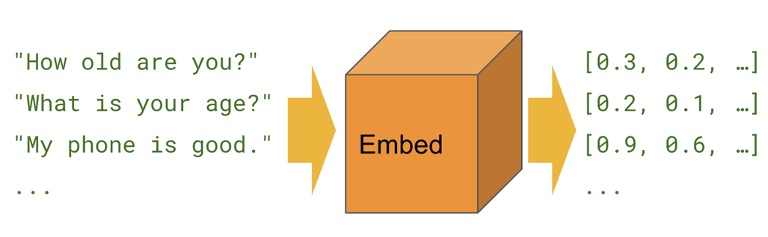
Sentence Embedding

Slide 4
Universal Sentence Embedding
Text Classification
Language modelling
“How old are you?”
Embed
Feature Vector
[0.2 0.1 …]
Machine Translation
...
Notes:
General purpose vector representations for sequence of words
Used for large number of NLP tasks
Tasks with word embeddings costlier than sentence embeddings
Better performance in various NLP tasks

Slide 5
Biomedical Domain
Task
Data
Model
Notes:
Data: Source, Distribution (labels etc), Terminology
Model: Number of models

Slide 6



Notes:
30M Articles
MEDLINE articles
Life Science Journals
Online Books
Abstract + Title
Start with a subset - 13K publications
Later (Neurodegenerative diseases)

Slide 7
Dataset Features
PMID | ABSTRACT | TITLE | JOURNAL | CITATIONS | KEYWORDS
3062849 | Polymer nanopart ... | Biocompatible Polym... | Journal of functional... | 46879128, 3679128, ... | Cancer therapy |drug delivery| ..
3062850 | Human Neuroblast... | Increasing TRM2... | Cells | 4628142, 1231210, ... | TRMP2|human neuroblastoma|..
3062851 | To examine the ... | Association between ... | International review of ... | 3453192, 2412441, ... | Cholesterol|Cognitive Dysfunction|..
Notes:
Work with Abstract + Title first.
Use keywords, citations and other dataset features for other downstream task.

Slide 8
Existing Models
Supervised:
  InferSent [Conneau et al., 2017]
Unsupervised:
  Skip-Thought [Kiros et al., 2015]
  Quick-Thought [Logeswaran and Lee, 2018]
Semi-supervised:
  GenSen [Subramanian et al., 2018]
  Universal Sentence Encoder [Cer et al., 2018]

Slide 9
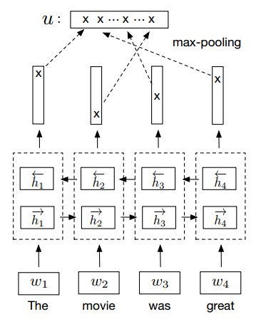
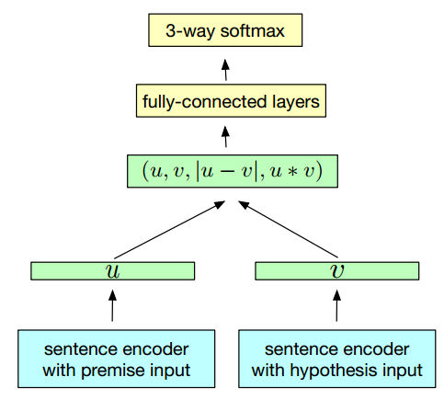
InferSent
SNLI dataset [Bowman et al., 2015]
  570k sentence pairs
[Conneau et al., 2017]
Notes:
Less data than unlabeled ones
More semantic oriented

Slide 10
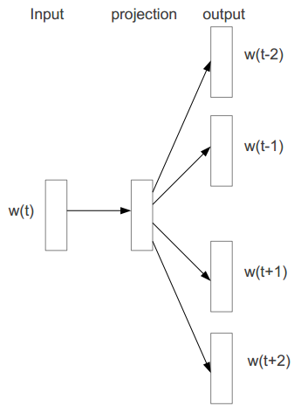
Unsupervised Models
Skip-Thought [Kiros et al., 2015]
Quick-Thought [Logeswaran and Lee, 2018]
[Mikolov et al., 2013]
Notes:
Skip-Thought: skip-gram on sent. lvl (predict surrounding sent.) (encoder-decoder)
Quick-Thought: replace decoder with a classifier to choose from candidates

Slide 11
GenSen
Seq2Seq Models
  Skip-Thought [Kiros et al., 2015]
  Translation
  Parsing
  SNLI [Bowman et al., 2015]
[Subramanian et al., 2018]

Slide 12
Universal Sentence Encoder
Transformer [Vaswani et al., 2017]
Deep Averaging Network (DAN) [Iyyer et al., 2015]
SNLI [Bowman et al., 2015]
[Cer et al., 2018]
Notes:
Transformer: sum of word rep.
Deep Averaging Network (DAN)
Semi-supervise: SNLI

Slide 13
Pre-Trained Language Models
ELMo [Peters et al., 2018]
BERT [Devlin et al., 2018]
Notes:
Word-lvl representations

Slide 14
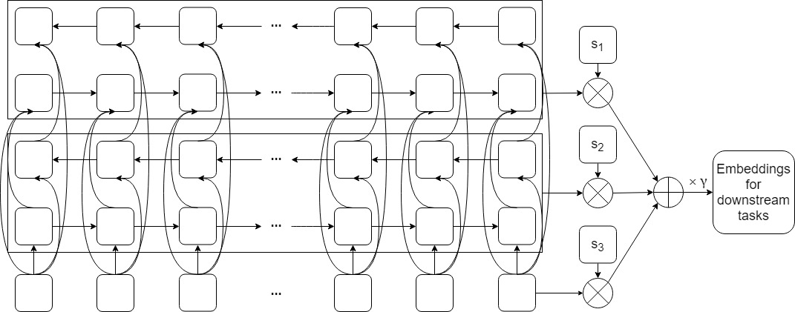
ELMo
[Peters et al., 2018]
Notes:
Weighted sum of biLM

Slide 15
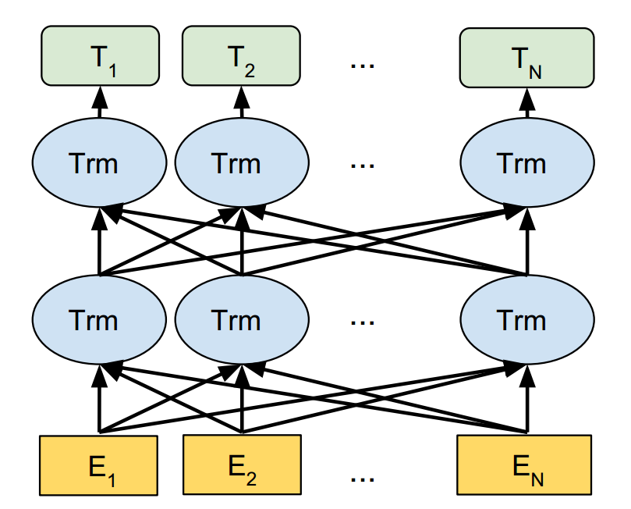
BERT
[Devlin et al., 2018]
Notes:
Masked language model

Slide 16
Biomedical Models
BioSentVec [Chen et al., 2018]
  Sent2vec [Pagliardini et al., 2017]
BioBERT [Lee et al., 2019]
  fine-tuning
Notes:
Sent2vec as an unsupervised version of fasttext, and an extension to word2vec

Slide 17
Our Approach
With PyTorch/Tensorflow as backend:
  Do
    Analyze
    Design
    Implement
    Experiments
    Evaluate
  Until Outperform
Notes:
Analyze prior results to find a promising direction to design and implement the model

Slide 18
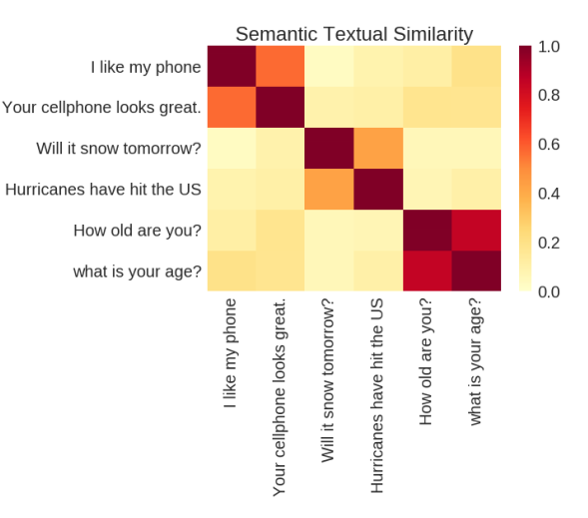
Semantic Textual Similarity
BIOSSES
  100 sentence pairs
  Similarity score in [0,4]
MedSTS
  1068 sentence pairs
  Similarity score in [0,5]
Figure from [Cer et al., 2018]
Notes:
Briefly describe the task and the datasets
Comparing to SNLI (570k sentence pairs), the two datasets are significantly smaller
In the clinical domain, STS can enable us to detect and eliminate redundant information that may lead to a reduction in cognitive burden and an improvement in the clinical decision-making process.

Slide 19
Baseline Performances
Models | BIOSSES | MedSTS
Avg. Word Embeddings | 0.694 | 0.747
Universal Sentence Encoder | 0.345 | 0.714
BioSentVec | 0.817 | 0.750
[Chen et al., 2018]
Notes:
We want to first reproduce the results, and to look at the performances of models previously mentioned, but not listed by BioSentVec paper/website.

Slide 20
Evaluation Metrics
Transferability
Visualization
  Sentence Similarity
Probing Tasks
  Surface Information
  Syntactic/Semantic Information
Notes:
Transferability: performances on multiple downstream tasks
Visualization: Heatmap, vector space
Probing Tasks:
Surface Information: sent. length, topics, recover information of original words
Syntactic Information: word orders, hierarchical structure
Semantic Information: number of subjects/objects, fake sent. Detection, tense

Slide 21
Challenges
SNLI in Biomedical Domain
  InferSent : Models learned on SNLI can perform better on multiple tasks
Appropriate Alternatives
  Data
  Task
Notes:
SNLI - 570k sentence pairs, MC clf task
BIOSSES and MedSTS are small datasets, probably not as influential as SNLI in general NLP (GenSen and Universal Sent Encoder)
Hard to find appropriate task(s)/dataset(s) for multi-tasking in biomedical domain
Data: use citations to come up with a similarity score for 2 abstracts.
Tasks: fake sentence detection, abstract tagging, title prediction

Slide 22
Timestamps
2/25: Analyze
3/18: Design and Implement 1st Own Model
4/1: Experiments
4/15: Improve Model
4/29: Experiments
5/9: Hand in Report

Slide 23
References
[1] Conneau, A., Kiela, D., Schwenk, H., Barrault, L., & Bordes, A. (2017). Supervised learning of universal sentence representations from natural language inference data. arXiv preprint arXiv:1705.02364.
[2] Kiros, R., Zhu, Y., Salakhutdinov, R. R., Zemel, R., Urtasun, R., Torralba, A., & Fidler, S. (2015). Skip-thought vectors. In Advances in neural information processing systems (pp. 3294-3302).
[3] Logeswaran, L., & Lee, H. (2018). An efficient framework for learning sentence representations. arXiv preprint arXiv:1803.02893.
[4] Subramanian, S., Trischler, A., Bengio, Y., & Pal, C. J. (2018). Learning general purpose distributed sentence representations via large scale multi-task learning. arXiv preprint arXiv:1804.00079.
[5] Cer, D., Yang, Y., Kong, S. Y., Hua, N., Limtiaco, N., John, R. S., ... & Sung, Y. H. (2018). Universal sentence encoder. arXiv preprint arXiv:1803.11175.
[6] Peters, M. E., Neumann, M., Iyyer, M., Gardner, M., Clark, C., Lee, K., & Zettlemoyer, L. (2018). Deep contextualized word representations. arXiv preprint arXiv:1802.05365.
[7] Devlin, J., Chang, M. W., Lee, K., & Toutanova, K. (2018). Bert: Pre-training of deep bidirectional transformers for language understanding. arXiv preprint arXiv:1810.04805.
[8] Chen, Q., Peng, Y., & Lu, Z. (2018). BioSentVec: creating sentence embeddings for biomedical texts. arXiv preprint arXiv:1810.09302.
[9] Pagliardini, M., Gupta, P., & Jaggi, M. (2017). Unsupervised learning of sentence embeddings using compositional n-gram features. arXiv preprint arXiv:1703.02507.
[10] Lee, J., Yoon, W., Kim, S., Kim, D., Kim, S., So, C. H., & Kang, J. (2019). BioBERT: pre-trained biomedical language representation model for biomedical text mining. arXiv preprint arXiv:1901.08746.
[11] Bowman, S. R., Angeli, G., Potts, C., & Manning, C. D. (2015). A large annotated corpus for learning natural language inference. arXiv preprint arXiv:1508.05326.
[12] Vaswani, A., Shazeer, N., Parmar, N., Uszkoreit, J., Jones, L., Gomez, A. N., ... & Polosukhin, I. (2017). Attention is all you need. In Advances in Neural Information Processing Systems (pp. 5998-6008).
[13] Iyyer, M., Manjunatha, V., Boyd-Graber, J., & Daumé III, H. (2015). Deep unordered composition rivals syntactic methods for text classification. In Proceedings of the 53rd Annual Meeting of the Association for Computational Linguistics and the 7th International Joint Conference on Natural Language Processing (Volume 1: Long Papers) (Vol. 1, pp. 1681-1691).

Slide 24
Keynote
Biomedical NLP
Universal Sentence Embedding
Limited Domain-Specific Datasets and Models
Multi-Tasking
Transfer Learning

